Slide 1
Best place to date?
Just for CHENZHU
2018

Slide 2
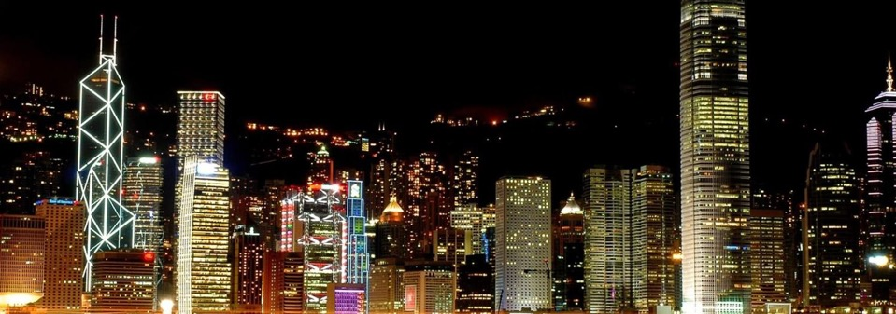
contents
01
02
03
04
Introduction
&Bussiness problem
Data
Methodology
Result
&Conclusion

Slide 3
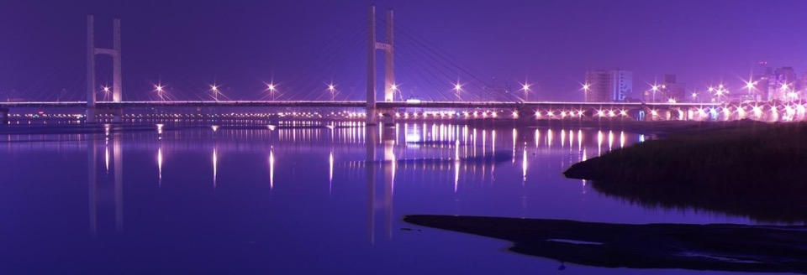
01
part
Introduction
Iis difficult to find a suitable One day‘s theme dating venue, such as the need to find a place in the middle of the week, you can have a quiet place to date dinner, but press the road to the subway station, hope to find a lively place on the weekend, in addition to eating and shopping, at the same time for the choice of cuisine for the choice The choice for single is a test. And now most of the software, such as the public comment, can only be based on the recommendations of the location and play, it is difficult to know with the interest of single men and women, this experiment will take me the subway station often visited as location information, go to foursquare I explored the types of play in the street, intuitively sorted the data from the places I used to go, extracted features, and helped me to visualize the characteristics of the date.

Slide 4

01
Business Problem
part
Here
Can cluster the place we dating and help us to learn about them for choosing with different purpose?

Slide 5


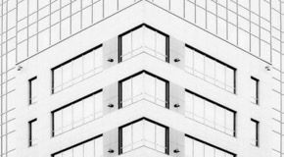
02
Data
part
Where is it and how can I prepare?
Collection
Understanding & Preparation
An open source data set of a foreign institution. Foursquare is a technology company that uses location intelligence to build meaningful consumer experiences and business solutions .The content of the data includes Pinpoint by Foursquare, Attribution by Foursquare, Place Insights by Foursquare and Pilgrim SDK by Foursquare（https://foursquare.com/） Further more, we also need to draw a map for the place I often visited with the help of the tool (http://www.gpsspg.com/maps.htm)
This data is all marked and unstructure data ,and there is not training set and test set. It is all about exploring and to see the feature. As for the data ,what we should do is to standerlization and visualize for overview understanding. Maybe we should pay more attention to Feature selection and the processing of missing values.

Slide 6
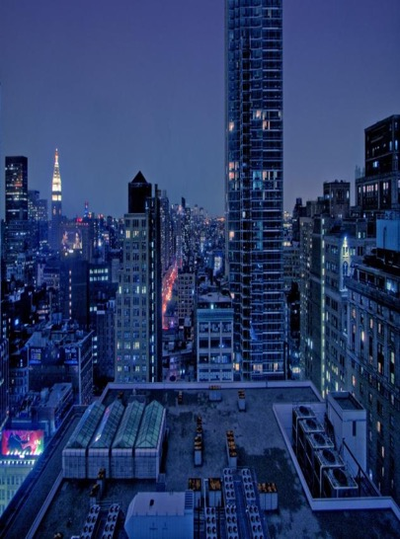
03
Methodology
part
Analytic Approach
First of all, the data we get is the street comprehensive data based on the latitude and longitude from foursquare. This data contains many dimensions. The problem to be solved is to explore the feature in cluster. There are not limited standards for weather it is right or false. Because we do not need to predict at this stage. We just want to find out the result of clusters from the data in entertainment facilities. The algorithm selected in this project is K-means. ).
01
Clustering is the division of data into groups such that data points in the same group are more similar than data points in other groups. In short, clustering is the division of data points with similar characteristics into groups, that is, clusters. The goal of the K-means algorithm is to find a group in the data, the number of groups being represented by the variable K. Each data point is assigned to one of the K groups by an iterative operation based on the characteristics provided by the data.
02

Slide 7
03
Methodology
part
As for the advantages and disadvantages:
For processing large data sets, the algorithm is relatively scalable and efficient because its complexity is approximately O(nkt), where n is the number of all objects, k is the number of clusters, and t is the number of iterations. Usually k<<n. This algorithm usually converges locally.
The algorithm attempts to find the k partitions that minimize the value of the squared error function. When the clusters are dense, spherical or lumpy, and the difference between clusters and clusters is obvious, the clustering effect is better.
1
2
3
The algorithm is simple and easy to implement;
High requirements on data types, suitable for numerical data;
Sensitive to the cluster value of the initial value, which may result in different clustering results for different initial values;
Not suitable for finding clusters with non-convex shapes, or clusters with large differences in size.
Sensitive to "noise" and outlier data, a small amount of this type of data can have a significant impact on the average.
1
2
3

Slide 8
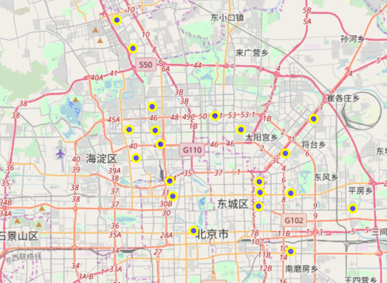
04
Result & Conclusion
part
Subways overview
We have choosen about 20 subway station where chenzhu oftenly visit and explore the possbilities around the subways.

Slide 9
04
Result & Conclusion
part
Categories overview
After we requseted from foursquare for the facilities around station we choose, there are 1468 results there. And we check the categories in 1468 items.
There are 155 uniques categories.

Slide 10
04
Result & Conclusion
part
Frequency
We changed the data of string for categories in to number and show the frequency

Slide 11
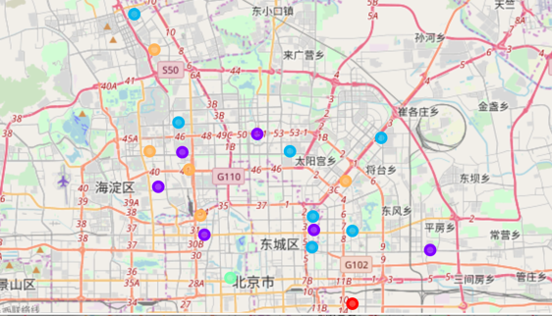
04
Result & Conclusion
part
Result
We descide to choose 10 features to cluster
And the final result is like this there 5 clusters in the map

Slide 12
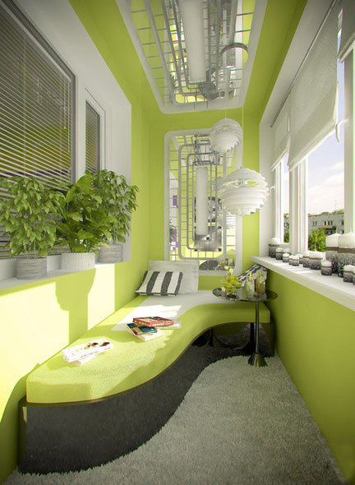
04
Result & Conclusion
part
We check the details of 5 clusters. There 2 clust only contain 1 item, so we just discuss the rest 3 cluster.
We count the second cluster and see pic here We found 34 cat here and most of them are Coffee Shop, Chinese Restaurant, Fast Food Restaurant and Café. We call it local style cluster.
We count the third cluster and see pic here We found 29 cat here and most of them are Hotel,Japanese Restaurant,Shopping Mall,Korean Restaurant,Cocktail Bar,Fast Food Restaurant,Peking Duck Restaurant,Italian Restaurant ,Brewery,Asian Restaurant,French Restaurant,American Restaurant,Spanish Restaurant,Eastern European Restaurant,Cantonese Restaurant,Xinjiang Restaurant,Hunan Restaurant and Pizza Place. We call it tasty food in different countries cluster.
We count the fifth cluster and see pic here We found 28 cat here and most of them are between the second cluster and the third cluster. We call it choose it when you don't know what to choose cluster.

Slide 13
04
Result & Conclusion
part
Chose like this
2nd Cluster
3rd Cluster
5th Cluster
As for the second cluster(local style cluster.), chenzhu can choose when he want to have the chinese food for date and which is more convient for him to get there.
As for the third cluster(tasty food in different countries cluster), chenzhu can choose from them when he want to taste something new and walk around for more. It must be more expensive and funny.
As for the last cluster (choose it when you don't know what to choose cluster.), chenzhu can choose them when he don't have any strong feeling to somme places.

Slide 14
thanks
2018

